Slide 1


A Comparative Study of Stochastic Pure Death Process and Cox Proportional Hazard Models in analyzing survival of breast cancer among Netherlands Women
Oladipo Afolayan, Jeremiah Akpabio, Sandile Ndabezitha,
Francis Nkansah, Aaron Niecestro
Notes:
Jeremiah starts

Slide 2

Table of Contents
Background
Objective
Data Description
Description of Models
Methods
Simulations and results
Discussion
Conclusion
Future Analysis
References

Slide 3

Background
Cancer is a 2nd leading cause of non-communicable disease behind CVDs
  Cancer burden:
    Prevalence - 19.3 million by 2020
    Mortality- over 10 million in the same year.
Breast cancer:
  Became the second most diagnosed cancer globally in 2020
  2.3 million incident cases in 2020
  685,000 deaths reported in the same year.
  Primary cause of cancer death in females
  5th cause of overall cancer related death globally.
  Approximately 5–10% genetic or hereditary cause (BRCA1 or BRCA2 mutations)
  Though a majority of diagnosed patients have no 1st degree family history
  Global age standardized incidence rate in females - 48 per 100,000 of the population,
    30 per 100,000 - sub- Saharan Africa
    Over 70 per 100,000 - Western Europe and North America

Slide 4
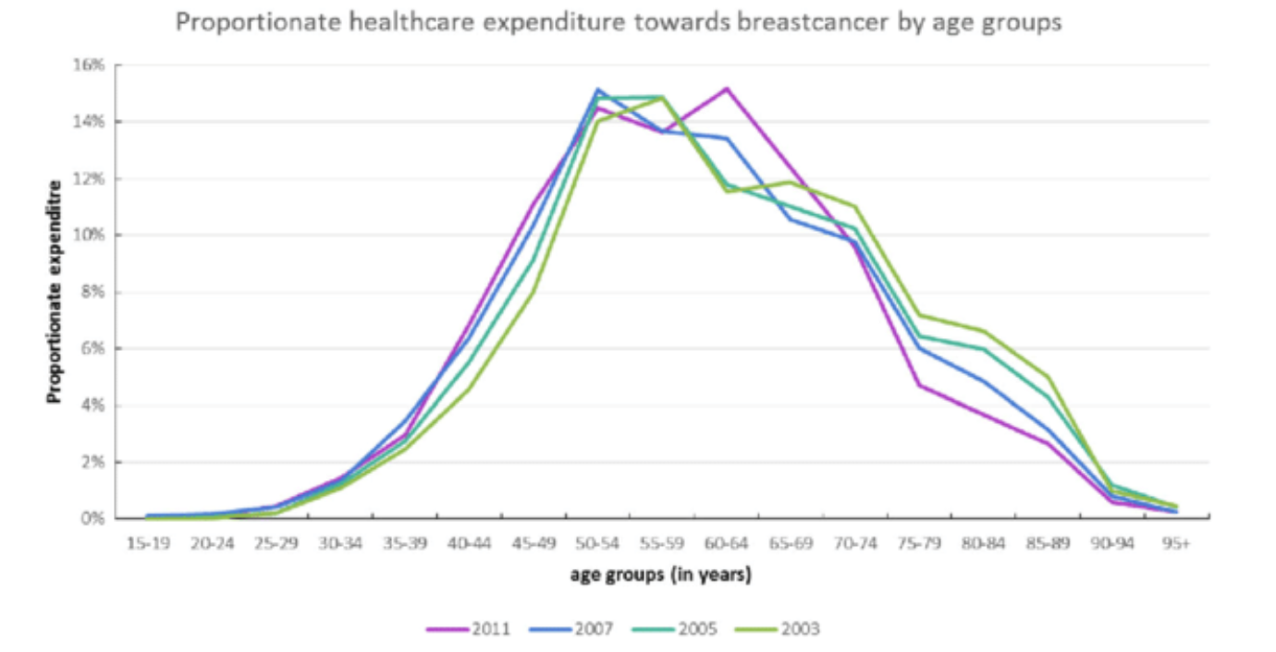
Theoretical framework of Breast Cancer in Netherlands
Case Study - Third in countries affected by the burden of cancer in Europe (Behind Ireland and Denmark.)
Dutch women diagnosed with invasive breast cancer yearly - 14,000 cases
2,400 - breast cancer in situ.
Epidemiology
Mortality rate - 3,000 yearly
Odds of diagnosis: 1 in every 8
Most prevalent cancer in the country
Mean age of diagnosis - 61 years.
Ten-year overall breast cancer survival rates:
Early: 87% to 93%
Locally advanced: 41% to 62%
Metastatic: 6% to 9%
DALYs: 65,000 Disability Adjusted Life Years
YLs: 26,000 life years lost,
Economic burden: €1.27 billion.
Notes:
Situ means macroscopically invisible but visualized microscopically
The increase was driven by ductal carcinoma in situ (DCIS) and early breast cancer
Incidence of locally advanced and metastatic breast cancer remained stable
Jeremiah part ends here

Slide 5
Aim & Objective
Aim:
Compare the efficacy of the pure death process and Cox proportional hazard model.
Objective:
To obtain a pure death process model and Cox proportional hazard model to predict the hazard rates for 272 women with breast cancer in the Netherlands.
Run 10,000 simulations for the Pure Death Process and find the mean, standard deviation, standard error, and coverage probability.
Determine whether using a stochastic pure death process model or a survival analysis cox proportional hazards model is better

Slide 6
Data Description
Dataset was published in 2016
272 breast cancer patients in the Netherlands
Primary focus of the data was a network built using only gene expression
Survival (in years),
  Number of Censored Observations = 195 (71.69%)
  Number of Deaths = 77 (28.31%)
  Ranged from 0.711841 to 18.340862 years
Time to recurrence of a tumor (in years),
  Ranged from 0.271 to 18.340862 years
Tumor Grade (1,2, 3)
Treatment
  Chemotherapy, Hormonal, and Amputation
1555 Columns of data based on the gene expression
Age
  Ranged from 26-53 years old, mean 44.05
Notes:
Maybe talk about this in presentation - 1570 columns, but only 12 were useful for our analysis

Slide 7
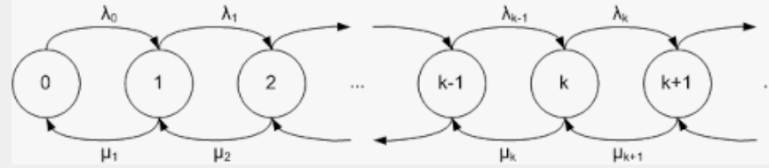
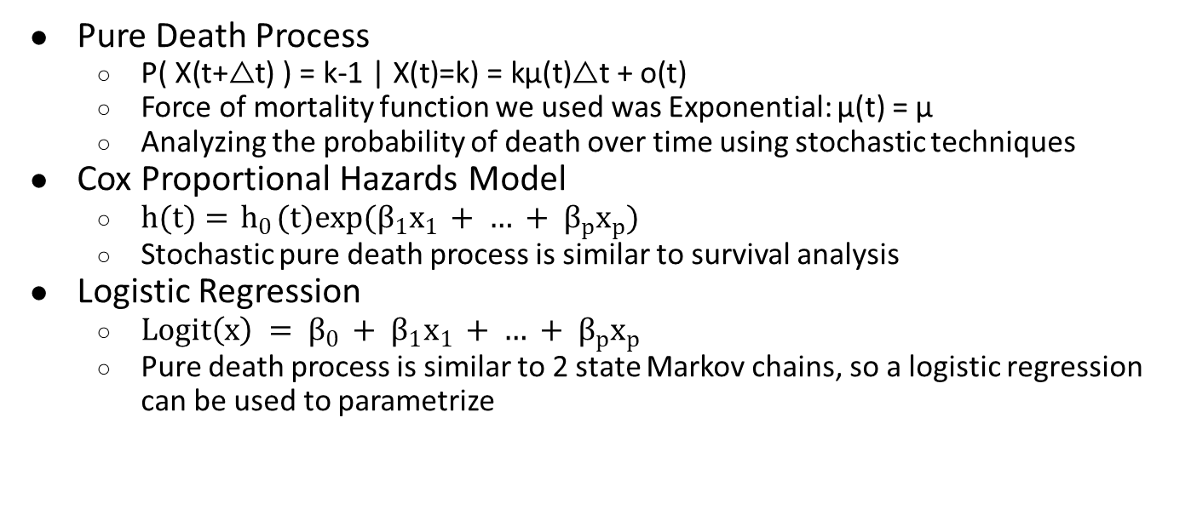
Model Descriptions
Pure Death Process
  $\text{P}\text{( }\text{X}\text{(}\text{t}\text{+△}\text{t}\text{) ) = }\text{k}\text{−1 | }\text{X}\text{(}\text{t}\text{)=}\text{k}\text{) = }\text{k}\text{μ}\text{(}\text{t}\text{)△}\text{t}\text{ + }\text{o}\text{(}\text{t}\text{)}$
  Force of mortality function we used was Exponential: μ(t) = μ
  Analyzing the probability of death over time using stochastic techniques
Cox Proportional Hazards Model
  $h(t)={ h}_{0}(t)exp(β_{1}x_{1 }+ … + β_{p}x_{p})$
  Stochastic pure death process is similar to survival analysis
Logistic Regression
  $Logit\left(x\right) = β_{0 }+ β_{1}x_{1 }+ … + β_{p}x_{p}$
  Pure death process is similar to 2 state Markov chains, so a logistic regression can be used to parametrize
Notes:
Using logistic regression as a parameterization of the pure death process
Oladipo part ends here

Slide 8
Methods
Analysis was conducted using R
Running 10,000 simulations of the pure death process
  Calculating the statistics
Based on the simulation of the population at the end of each year, use survival analysis approach
  i.e. calculating Kaplan-Meier and Nelson-Aalen estimators and creating visualisations
Using the real data to compare the basic survival analysis tools with simulations
Analyzing an optimal Cox Proportional Hazards Model
Analyzing an optimal Logistic Regression Model
Notes:
Optimal means C-statistic and Area under the Curve greater than 90% like in simulations coverage prob

Slide 9
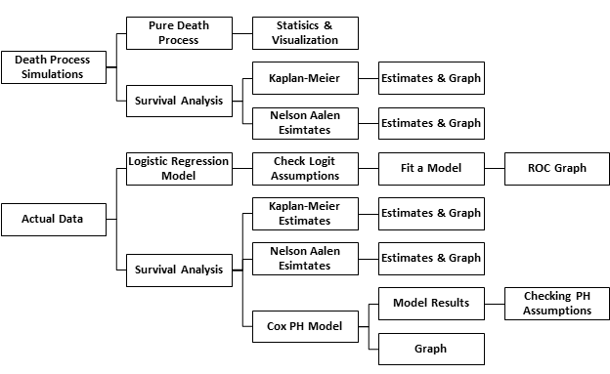
Flow Chart of Research
Notes:
Mention death rate when someone talks about this slide

Slide 10
Pure death process simulation
Number of Simulations | 10,000
Number of Simulation Years | 18.34
Initial Population | 272
True Death Rate | 0.018
Significance Level | 0.05
Notes:
Sandile starts here

Slide 11
Simulation Statistics
Time (Years) | True Death Rate | Estimated Death Rate | Standard Deviation | Standard Error | Coverage Probability
0-18.4 | 0.018 | 0.01747 | 0.001905 | 0.00002 | 0.988
Time (Years) | True Death Rate | Estimated Death Rate | Standard deviation | Standard Error | Coverage Probability
0 to 5 | 0.0397 | 0.0331 | 0.00499 | 0.00005 | 0.971
6 to 10 | 0.01249 | 0.0114 | 0.00204 | 0.00002 | 0.947
11 to 15 | 0.005 | 0.0047 | 0.00107 | 0.00001 | 0.962

Slide 12
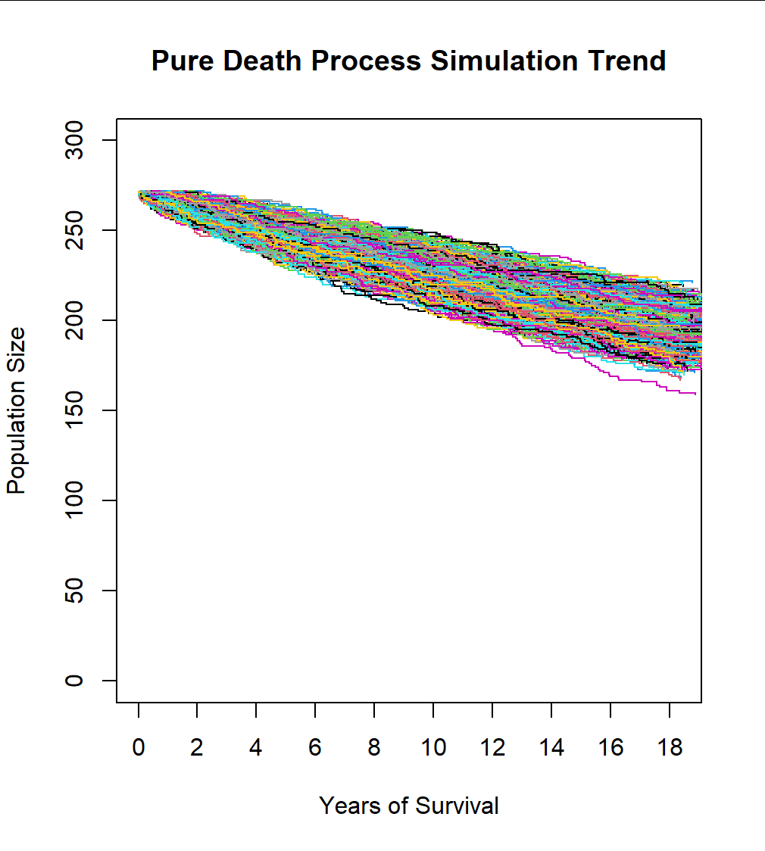
Pure death process - Remaining Population

Slide 13
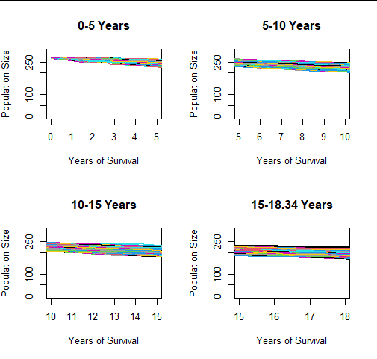
Pure Death Process - 5 Year Intervals
Notes:
Change 10,000 simulations
Sandile part ends here

Slide 14
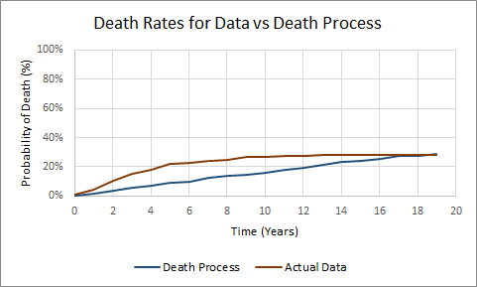
Pure death process
Notes:
The blue color is the cumulative average death rate from the remaining population slide across 10,000 simulations like you saw earlier
Francis takes this slide

Slide 15
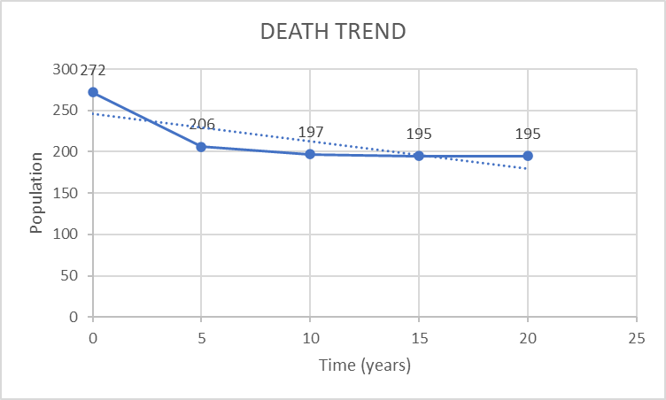

Linear Pure Death Trend
Linear Death Model: $P\left[Y\left(t+△t\right)=k−1 | Y\left(t\right)=k\right]= 0.018k△t$
First 5 years: $P\left[Y\left(t+△t\right)=k−1 | Y\left(t\right)=k\right]= 0.0397k△t$
6 to 10 years: $P\left[Y\left(t+△t\right)=k−1 | Y\left(t\right)=k\right]= 0.01249k△t$
11 to 15 years: $P[Y(t+△t)=k−1|Y(t)=k] = 0.005k△t$
Notes:
The dotted line is the linear pure death trend. The dotted line is the approximation of a linear solid blue line
Francis takes this slide

Slide 16

Logistic Regression Model
$$P(Y=1)= \frac{Exp(1.06099−0.62604∗Time Rec + 1.4878∗Gr2+2.2629∗Gr3)}{1+Exp(1.06099−0.62604∗Time Rec + 1.4878∗Gr2+2.2629∗Gr3)}$$
Parameter | Coefficient | Exp(Coefficient) | Standard Deviation | P-value
Intercept | 1.06099 | 2.89 | 0.70076 | 0.130
Time of Tumor Recurrence | -0.62604 | 0.53 | 0.08441 | < 0.0001
Grade 2 | 1.48784 | 4.43 | 0.64553 | 0.0212
Grade 3 | 2.26292 | 9.61 | 0.6438 | 0.0004
Notes:
ODDs Tumor=0.53. 47% less chance of … ODDS of Grade 3= 9.6….. 8.6…
Francis starts here again

Slide 17
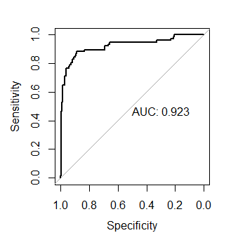
Area under the Curve (AUC) = 0.923

Slide 18
Simulations versus Real Data for Death Rates
 | Simulation |  | Actual Data
Year | Kaplan-Meier | Nelson-Aalen | Kaplan-Meier | Nelson-Aalen
0 | 0.0000 | 0.0000 | 0.0000 | 0.0000
3 | 0.0551 | 0.0546 | 0.1066 | 0.1039
6 | 0.0993 | 0.0984 | 0.2169 | 0.2121
9 | 0.1471 | 0.1458 | 0.2500 | 0.2452
12 | 0.1949 | 0.1932 | 0.2721 | 0.2672
15 | 0.2390 | 0.2370 | 0.2831 | 0.2783
18 | 0.2721 | 0.2698 | 0.2831 | 0.2783

Slide 19
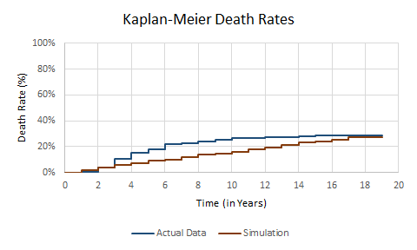
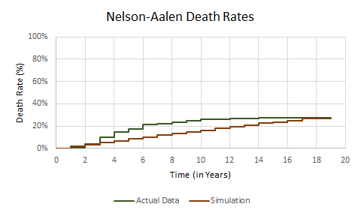
Simulation vs Real Data in Survival Analysis Graphs

Slide 20
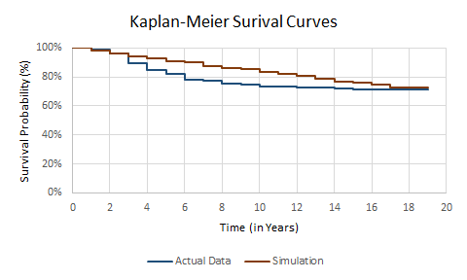
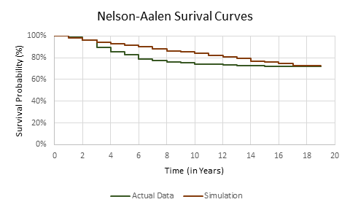
Simulation vs Actual Data in Survival Analysis Graphs

Slide 21
Cox Proportional Hazards Model
Concordance (C-Statistic) = 0.949 (+/- 0.008)
Risk Factor | Parameter Estimate | Exp(Parameter Estimate) | Standard Error | P-value | Confidence Interval
Log(Time of Tumor Recurrence) | -1.5998 | 0.2019 | 0.1175 | < 2e-16 | (0.1604, 0.254)
Tumor Grade = 2 | 1.2082 | 3.3473 | 0.5424 | 0.0259 | (1.1561, 9.6916)
Tumor Grade = 3 | 1.5915 | 4.9113 | 0.5384 | 0.0031 | (1.7096, 14.1091)
Notes:
Aaron part ends here

Slide 22
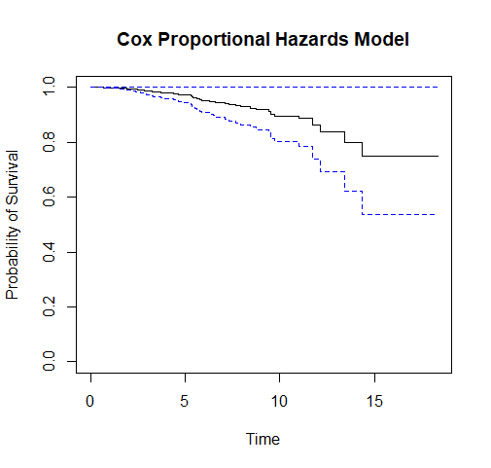
Graph for Cox PH Model
Survival rate at
  5 Years ≈ 0.97
  10 Years ≈ 0.89
  15 Years ≈ 0.78
  18 Years ≈ 0.78
Hazard rate at
  5 Years ≈ 0.03
  10 Years ≈ 0.11
  15 Years ≈ 0.22
  18 Years ≈ 0.22
Notes:
Aaron part ends here

Slide 23
Discussion
Coverage Probability of Death Process Simulations > 90%
Logistic Regression Area under the Curve = 0.923
Cox PH C-statistic = 0.949
Based on our analysis, our models predict the death and survival very well
Notes:
Aaron take this slide

Slide 24
Useful R Packages for Birth-Death Process
DOBAD
  Provides Frequentist (EM) and Bayesian (MCMC) Methods for Inference of Birth-Death-Immigration Markov Chains
    Does not work for pure birth, pure death, pure immigration
msm
  Include the ability to model transition rates and hidden Markov output models in terms of covariates, and the ability to model data with a variety of observation schemes, including censored states
    This packages work for multi-state Markovs but not for pure process models converted in Markov Chains
Notes:
Aaron stops here

Slide 25
Conclusion
Based on our analysis, although the Cox PH Model outperformed the logistic regression model with their statistics (AUC, and C-statistic), we believe that the pure death process model approach using logistic regression was more efficient and better than the survival model
This is because in the Cox PH model, the tradeoffs of taking away the treatment and subject’s age variables were much steeper of a price
Challenge with the code, not being able to use R packages
Notes:
Jeremiah ends slide presentation from here

Slide 26
Future Analysis
Debug and run the Pure Death Process model with our actual data in R or SAS
Find other breast cancer survival data with a larger sample size and run the same analysis to see if the results differ
Find other cancer survival data with a larger sample size and run the same analysis to see if the results differ
Re-do analysis with more emphasis on other covariates (keeping them in the model)
Notes:
The reason we did not include other covariates was because we wished for the area under the curve and c-statistic to be greater than 90% showing that the pure death process simulation worked very well in other models

Slide 27
Acknowledgement
We wish to acknowledge Dr. Wenyaw Chan for all his help with our data analysis

Slide 28
References
1. Wilkinson L, Gathani T. Understanding breast cancer as a global health concern. Br J Radiol. 2022;95(1130):7–9.
2 Breast cancer [Internet]. [cited 2023 Apr 14]. Available from:https://www.who.int/news-room/fact-sheets/detail/breast-cancer
3. The Netherlands has one of the highest incidences of cancer in Europe - DutchNews.nl [Internet]. [cited 2023 Apr 14]. Available from: https://www.dutchnews.nl/news/2020/08/the-netherlands-has-one-of-the-highest-incidences-of-cancer-in-europe/
4. Breast cancer in the Netherlands | RIVM [Internet]. [cited 2023 Apr 14]. Available from: https://www.rivm.nl/en/breast-cancer-screening-programme/breast-cancer-in-netherlands
Vondeling GT, Menezes GL, Dvortsin EP, Jansman FGA, Konings IR, Postma MJ, et al. Burden of early, advanced and metastatic breast cancer in The Netherlands. BMC Cancer. 2018;18(1):1–11.
Van Maaren MC, de Munck L, Strobbe LJA, Sonke GS, Westenend PJ, Smidt ML, et al. Ten-year recurrence rates for breast cancer subtypes in the Netherlands: A large population-based study. Int J Cancer. 2019;144(2):263–72
Paton, L., Troffaes, M.C.M., Boatman, N., Hussein, M., Hart, A. (2014). Multinomial Logistic Regression on Markov Chains for Crop Rotation Modelling. 2014.
S. Vairavan, L. Eshelman, S. Haider, A. Flower and A. Seiver, "Prediction of mortality in an intensive care unit using logistic regression and a hidden Markov model," 2012 Computing in Cardiology, Krakow, Poland, 2012, pp. 393-396.

Slide 29
Bray F, Laversanne M, Weiderpass E, Soerjomataram I. The ever-increasing importance of cancer as a leading cause of premature death worldwide. Cancer. 2021;127(16):3029–30.
Pocock SJ, Gore SM, Kerr GR. Long term survival analysis: The curability of breast cancer. Stat Med. 1982;1(2):93–104.
Neyman J. Proceedings of the Fourth Berkeley Symposium on Mathematical Statistics and Probability: Held at the Statistical La boratory, University of California, June 30-July 30,l960. University of California Press; 1961. 436 p.
Lum, P., Singh, G., Lehman, A. et al. Extracting insights from the shape of complex data using topology. Sci Rep 3, 1236 (2013). https://doi.org/10.1038/srep01236
Nicolau, Monica, et al. “Topology Based Data Analysis Identifies a Subgroup of Breast Cancers with a Unique Mutational Profile and Excellent Survival.” Cloudfront.net, Proceedings of the National Academy of Sciences of the United States of America, 11 Apr. 2011, https://d1bp1ynq8xms31.cloudfront.net/wp-content/uploads/2015/02/Topology_Based_Data_Analysis_Identifies_a_Subgroup_of_Breast_Cancer_with_a_unique_mutational_profile_and_excellent_survival.pdf.
Chang J, Chan HK, Lin J, Chan W. Non-homogeneous continuous-time Markov chain with covariates: Applications to ambulatory hypertension monitoring. Stat Med. 2023 Mar 10. doi: 10.1002/sim.9707. Epub ahead of print. PMID: 36896833.
Barraza NR, Pena G, Moreno V. A non-homogeneous Markov early epidemic growth dynamics model. Application to the SARS-CoV-2 pandemic. Chaos Solitons Fractals. 2020 Oct;139:110297. doi: 10.1016/j.chaos.2020.110297. Epub 2020 Sep 18. PMID: 32982083; PMCID: PMC7500902.

Slide 30


Thank you, Siyabonga!

